Slide 1

GATEWAY LOAD BALANCER(GWLB)
UNDER THE GUIDANCE OF : MS.T.ANANDHI
NAME OF THE STUDENT : D.MAHENDRA REDDY
REGISTER NUMBER:41110343

Slide 2
PRESENTATION OUTLINE
Course Certificate
Abstract
Introduction
Objectives
Applications
Software and Hardware Requirements
System Architecture
Snapshots
Conclusion
References

Slide 3
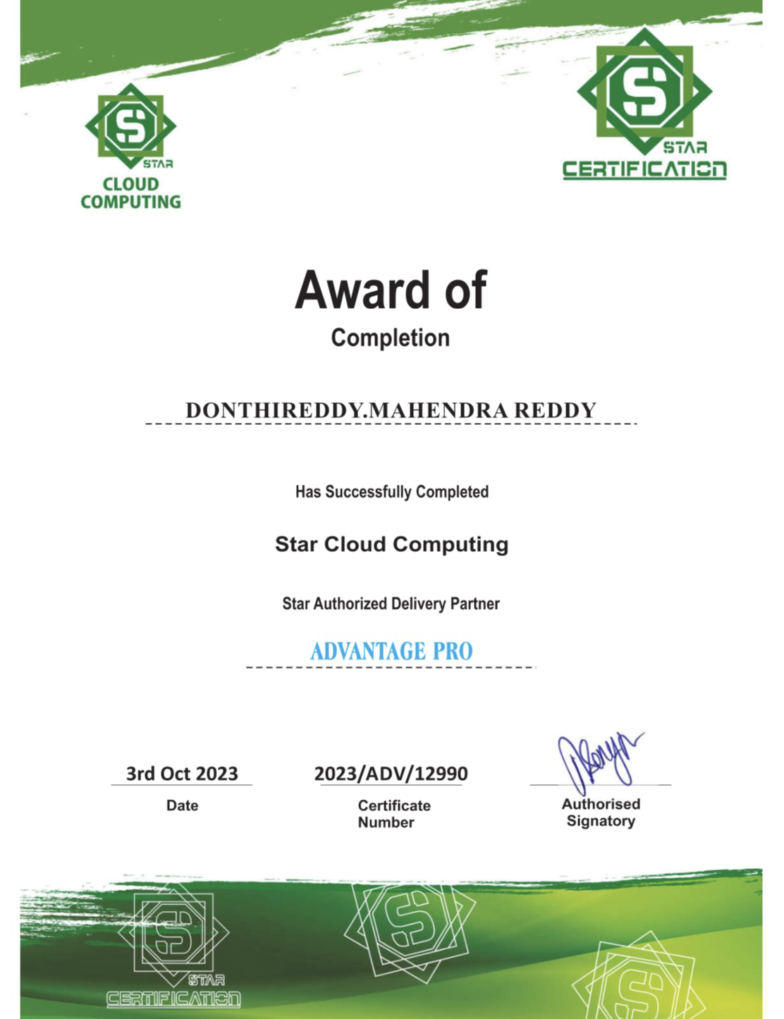

Slide 4
ABSTRACT
AWS Gateway Load Balancer (GWLB) is an Elastic Load Balancing (ELB) service operates at the third layer of the Open Systems Interconnection 105 model, the network layer. It listens for all IP packets across all ports and forwards trallic to the target group that's specified in the listener Gateway Load Balancer helps you easily depic scale, and manage your third-party virtual rule. appliances. It gives you one gateway for distributing traffic across multiple virtual appliances while scaling them up or down, based on demand your network and increases availability. It ensures high availability and reliability by r appliances, and rerouting flows when a virtual appliance becomes unhealthy. To ensure that your virtual appliances are available and healthy, Gateway Load Balancer runs health checks on each virtual appliance instance on a configurable cadence. if the number of consecutive failed tests This decreases potential points of failure in O exceed a set threshold, the appliance will be declared unhealthy and traffic will no longer be routed to that instance. touting traffic flows through healthy virtual Gateway Load Balancer combines a transparent network gateway (that is, a single entry and exit point for all traffic) and a load balancer that distributes traffic and scales your virtual appliances with the demand. You can send traffic to GWLB by making simple configuration updates in your VPCs' route tables. With GWLB, customers can scale their virtual appliances elastically by load balancing traffic across a fleet of virtual appliances, GWLB improves availability by routing traffic flows through healthy virtual appliances, and reroutes flows when an appliance becomes unhealthy.With GWLB, you can use your own appliances of choice in AWS and rely on GWLB to manage their scale and availability needs, while retaining skillsets and existing processes. You can also scale your virtual appliances elastically by load balancing traffic across a fleet of virtual appliances. The scaling up and down of appliances reduces costs. GWLB sends both directions of the traffic flow to the same appliance, there by allowing the appliance to perform stateful traffic processing.GWLB and the virtual appliances exchange application traffic with each other using GENEVE encapsulation, which allows GWLB to preserve the content of the original traffic. GWLB uses Gateway Load Balancer Endpoint (GWLBe), a new type of VPC Endpoint powered by AWS PrivateLink, which can be a next-hop in the route table. This simplifies insertion of appliance services across VPC boundaries.

Slide 5
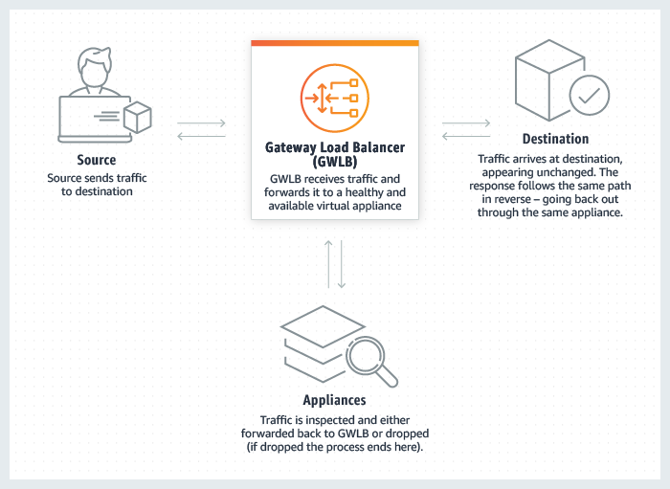

Slide 6
INTRODUCTION
A Gateway Load Balancer (GLB) is a network service provided by cloud providers like Amazon Web Services (AWS) that is designed to distribute incoming internet traffic across multiple target resources. It operates at the network layer (Layer 3) of the OSI model and is primarily used to enhance the availability, reliability, and security of applications and services hosted in the cloud.
Traffic Distribution: GLBs distribute incoming traffic across multiple target resources, such as Virtual Private Clouds (VPCs), data centers, or services. This distribution ensures that no single resource becomes overwhelmed with traffic, optimizing resource utilization.
High Availability: Gateway Load Balancers are designed to provide high availability and fault tolerance. They can distribute traffic across multiple availability zones or regions, reducing the risk of service disruption due to hardware failures or network issues.
Scalability: They support the scaling of applications and services by intelligently routing traffic to the appropriate backend resources. As traffic patterns change, Gateway Load Balancers can adapt to accommodate.
Granular Control: Gateway Load Balancers offer granular control over traffic routing. Administrators can define routing policies based on criteria such as destination IP address, port, or protocol. This flexibility allows for fine-tuning traffic distribution strategies.
Integration with Other Services: GLBs can integrate with other cloud services and features, such as Virtual Private Clouds (VPCs), security groups, and network access control lists (ACLs), to provide a comprehensive network solution.

Slide 7
OBJECTIVES
A “Gateway Load Balancer” is a type of load balancer that enables you to deploy, scale, and manage virtual appliances such as firewalls, intrusion detection and prevention systems, and deep packet inspection systems. It operates at the third layer of the Open Systems Interconnection (OSI) model, the network layer. It listens for all IP packets across all ports and forwards traffic to the target group that's specified in the listener rule. It maintains stickiness of flows to a specific target appliance using 5tuple (for TCP/UDP flows) or 3-tuple (for non-TCP/UDP flows). Gateway Load Balancers use Gateway Load Balancer endpoints to securely exchange traffic across VPC boundaries. A Gateway Load Balancer endpoint is a VPC endpoint that provides private connectivity between virtual appliances in the service provider VPC and application servers in the service consumer VPC.
Microsoft Azure also has a Gateway Load Balancer SKU that is catered for high performance and high availability scenarios with third-party Network Virtual Appliances (NVAs). With the capabilities of Gateway Load Balancer, you can easily deploy, scale, and manage NVAs.

Slide 8
APPLICATIONS
Gateway Load Balancer (GWLB) is a versatile service provided by Amazon Web Services (AWS) that can be applied to various use cases to improve the availability, scalability, and security of applications and services. Here are some common applications of Gateway Load Balancer:
Highly Available VPN (Virtual Private Network): Use GWLB to distribute VPN traffic across multiple VPN.Appliances in different Availability Zones (AZs), ensuring high availability and redundancy for your remote connectivity needs.
Firewall and Network Security:Deploy security appliances like firewalls and intrusion detection systems (IDS) behind GWLB to inspect and filter incoming traffic, enhancing the security of your applications and protecting against threats.3. *Multi-Tier Application
Architecture:Implement GWLB to distribute traffic across different tiers of your application, such as web servers, application servers, and databases, improving resource utilization and fault tolerance.

Slide 9
SOFTWARE & HARDWARE REQUIREMENTS
Hardware :
1. Processor - Intel Dual Core(32 bit)
2. RAM - 2GB
3. Processor Speed - 2GHZ
Software :
Server Hardware:
1)Virtual Machines(VM’S)
2)Network Configuration

Slide 10
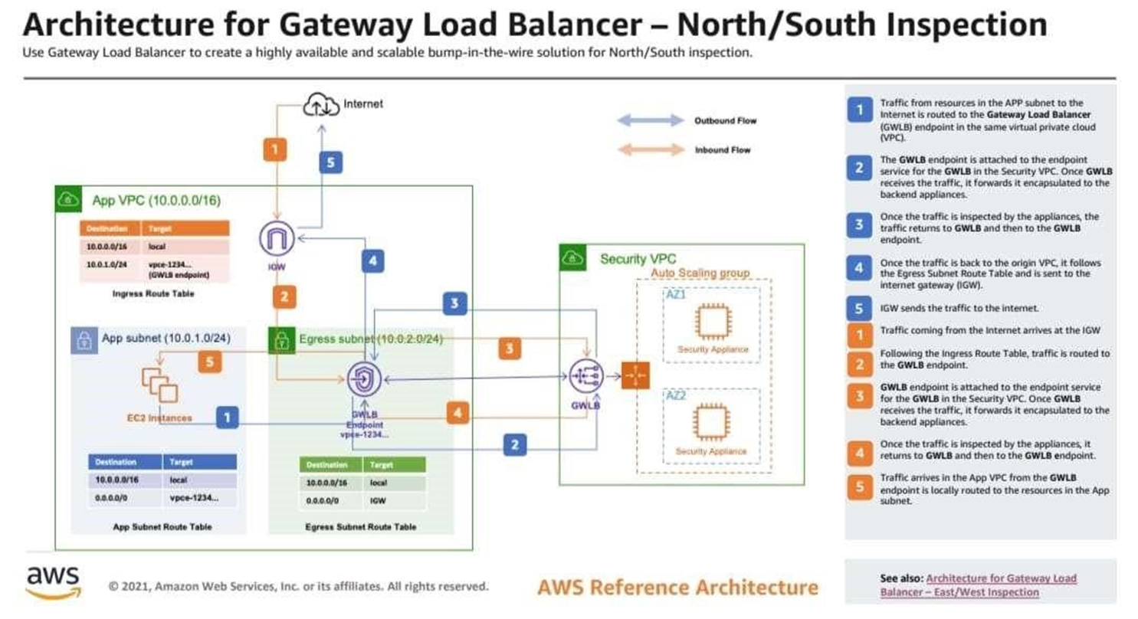
SYSTEM ARCHITECTURE

Slide 11
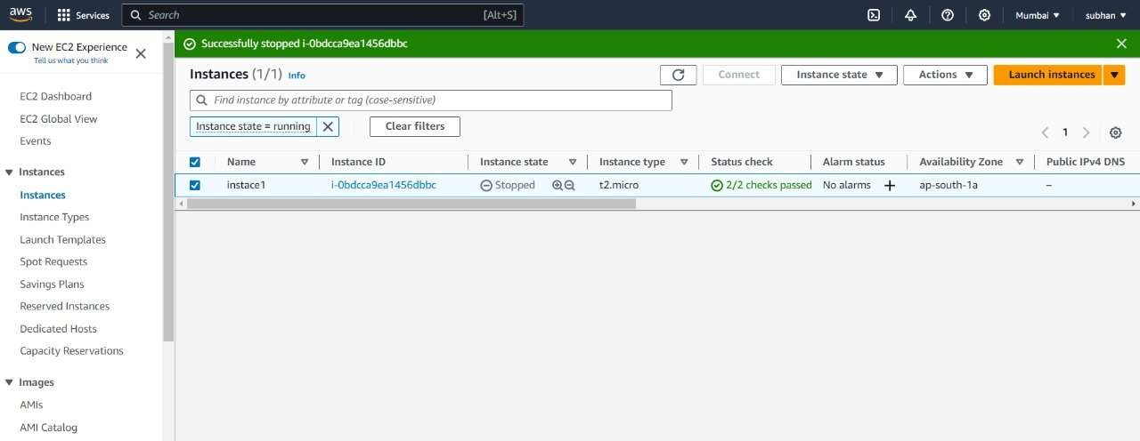
SNAPSHOTS

Slide 12
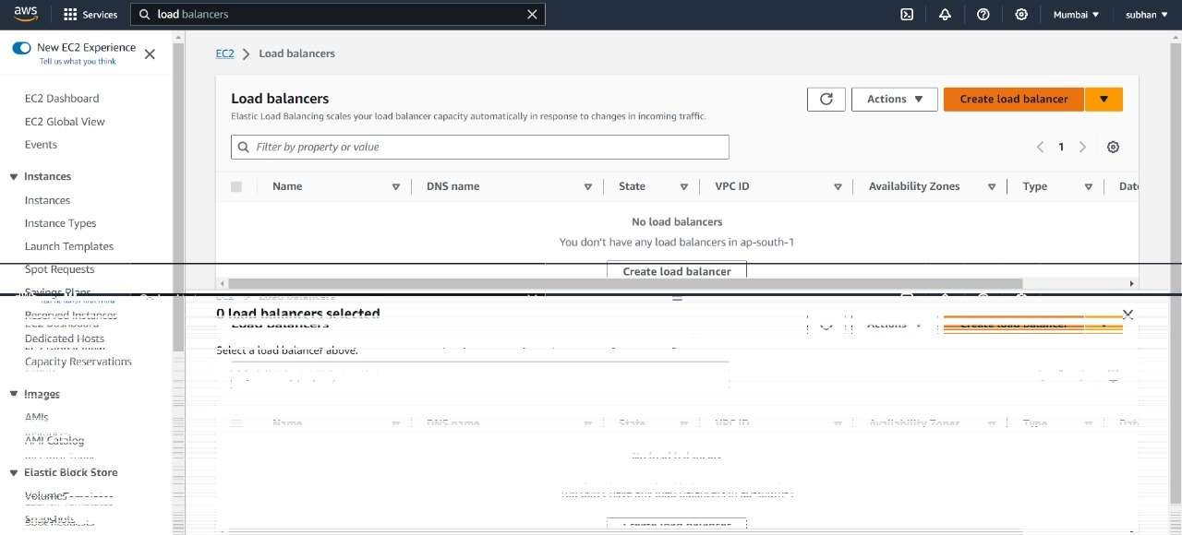
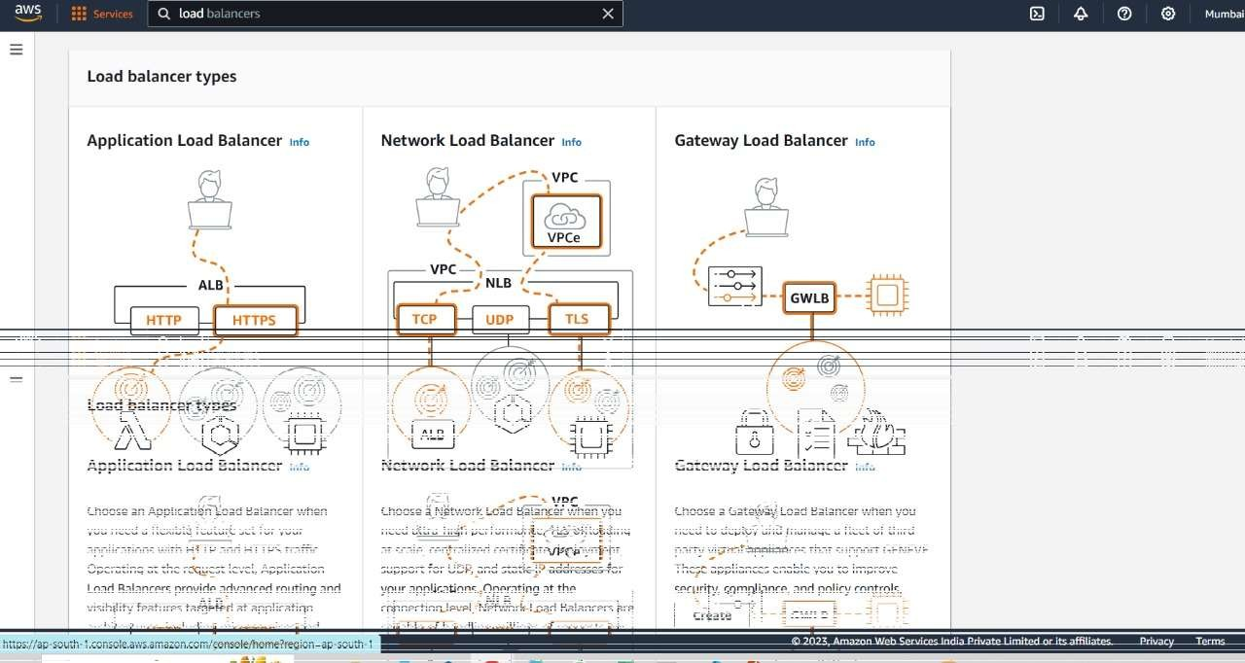

Slide 13
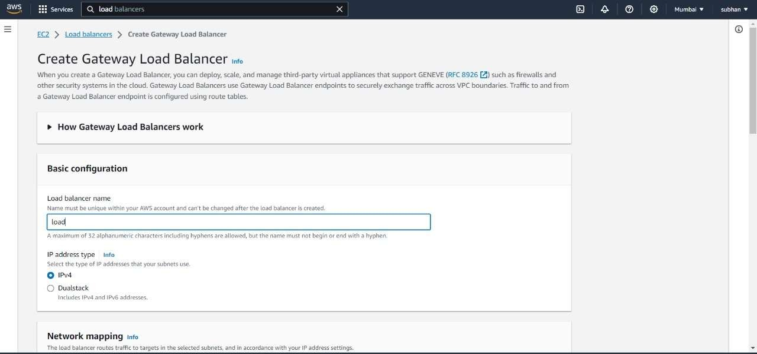
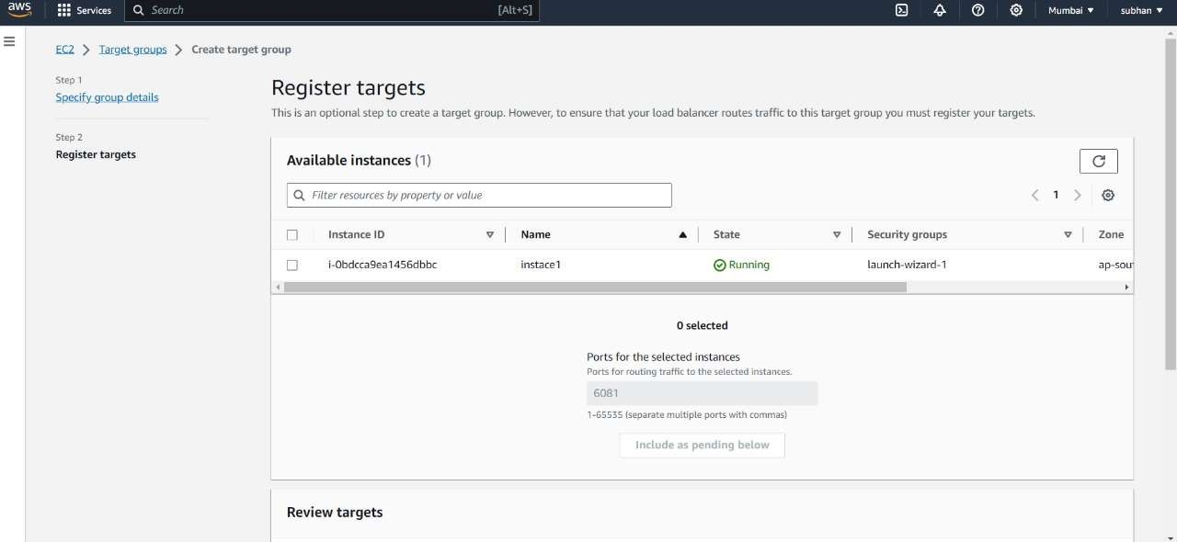

Slide 14
CONCLUSION
A Gateway Load Balancer (GWLB) is a crucial component in modern network architecture, providing high availability, scalability, and enhanced security for applications and services. By distributing incoming traffic across multiple targets and offering advanced routing capabilities, GWLBs ensure efficient and reliable access to resources.
As organizations continue to adopt cloud-based and hybrid environments, the importance of Gateway Load Balancers in optimizing network performance and maintaining service availability cannot be overstated.The AWS Gateway Load Balancer is massive, bringing to the cloud a capability that has never existed in traditional/legacy data center networks.
Gateway Load balancer combined with Gateway Load Balancer Endpoint provides customers with a highly available next hop for Transit Gateway VPC attachments in the Appliance VPC.
Gateway Load Balancer’s ability to check appliance health, use auto scaling groups as targets, and remain transparent to network traffic, makes it easier to centralize and scale fleets of firewalls and other virtual appliances. As a result, customers no longer need to create complex configurations, scaling mechanisms, and relying on manual health checks.
However, as we have seen, Gateway Load Balancer is not the only load balancer; there are many other load balancers offered by AWS, such as Classic Load Balancer, Application Load Balancer, and Network Load Balancer.

Slide 15
REFERENCES
A Survey on Gateway Load Balancing Techniques for Cloud Computing by A. M. Al- Shammari, N. Z. Jhanji, and Y. Al-Nabhan (2016). This paper provides a comprehensive survey of gateway load balancing techniques for cloud computing. It covers the different types of load balancers, the different load balancing algorithms, and the different factors to consider when choosing a load balancer for a cloud computing environment.
A Comparative Study of Gateway Load Balancing Algorithms in Cloud Computing byS. Kumar and P. Singh (2017). This paper compares the performance of different gateway load balancing algorithms in cloudcomputing. It considers metrics such as throughput, latency, and response time
A Comprehensive Survey of Gateway Load Balancing Techniques in Software Defined Networks (SDNs) by K. G. Kumar and M. R. Babu (2019).This paper provides a comprehensive survey of gateway load balancing techniques in software defined networks (SDNs). It covers the different types of load balancers, the different load balancing algorithms, and the different factors to consider when choosing a load balancer for an SDN environment.
A Review of Gateway Load Balancing Techniques in Cloud Computing by M. A. Razzaq, M. Hussain, and Y. Xiang (2020). This paper is an updated version of the authors' 2018 paper on gateway load balancing in the cloud. It includes new information on the latest gateway load balancing techniques and trends.

Slide 16


